Slide 1
DB Connectivity
COMP / IT 420 Lecture 9
March 29th, 2021

Slide 2
Updates and Announcements
Homework 3 is due on Tuesday, April 6th at 11:59pm
Database Design Part 3 is due Friday, April 16th at 11:59pm
There is no lab session this week.
Mid-term review today.
No lecture quiz today.

Slide 3
Overview
Database Recovery (basic information)
Database Connectivity and Architecture
Database Connections in Python (MySQL)
Database Connections in Java (MySQL)

Slide 4
Database Recovery Management
Database recovery: Restores database from a given state to a previously consistent state
Recovery of transactions is based on the atomic guarantee for database transactions
Reverses all changes made by a transaction before transaction failure (aborted, hardware / software failure, human error or natural disaster)

Slide 5
Basic Illustration of the Issue
Memory
Storage
READ(A)
WRITE(A)
COMMIT

Slide 6
Basic Illustration of the Issue
Memory
Storage
A = 1
READ(A)
WRITE(A)
COMMIT
A = 1

Slide 7
Basic Illustration of the Issue
Memory
Storage
READ(A)
WRITE(A)
COMMIT
A = 1
A = 2
A = 1

Slide 8
Basic Illustration of the Issue
Memory
Storage
READ(A)
WRITE(A)
COMMIT
A = 2
A = 1
A = 2

Slide 9
Basic Illustration of the Issue
Memory
Storage
READ(A)
WRITE(A)
COMMIT
A = 1
A = 2
A = 1
What do we do now?

Slide 10
Types of Failures
Transaction failures are either:
Logical errors within the transaction like bad or missing data, overflow, etc.
System errors preventing transaction from continuing (like deadlock)
System crash due to a hardware malfunction that causes volatile storage loss.
Disk failure in non-volatile storage.

Slide 11
Recovery Concepts
Fail-stop assumption that failures in system and in volatile memory are recoverable
Write-ahead-log protocol ensures that logs are written before data is updated in database.
Redundant transaction logs keep duplicate files in different locations
Database buffers provide temporary storage for faster updating followed by commits of large segments of memory
Database checkpoints writes all updated buffers (dirty) in memory to disk.

Slide 12
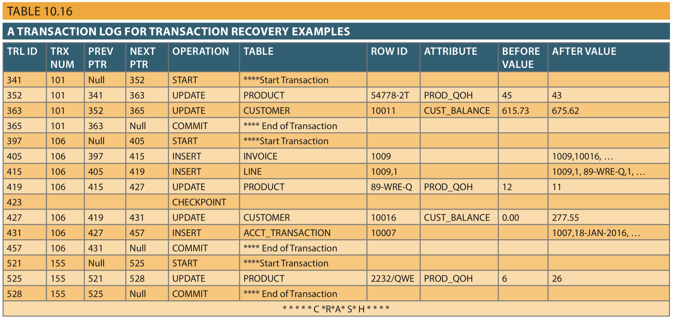

Slide 13
Recovery Procedures
Related to the use of database buffers and checkpointing, similar in concept to virtual memory and storage caching.
Deferred-write (update) technique updates the transaction log only. Physical updates are committed from the log file.
Write-through (immediate update) technique updates database during transaction and rolls back if needed. (Still writes to log first.)

Slide 14
The Transaction Log
The transaction log records the details of all transactions
Any changes the transaction makes to the database
How to undo these changes
When transactions complete and how
The log is stored on disk, not in memory
If the system crashes it is preserved, unless disk fails.

Slide 15
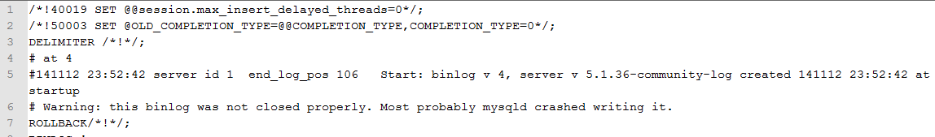
MYSQL-BIN-0000 (Example)
mysqlbinlog -u root \
../data/mysql-bin.000094 > mysql-bin.000094.output.txt
Binary logging (for recovery) and general query log (for everything)

Slide 16
Transaction Recovery
Keeps track of all transactions that update the database
DBMS uses the information stored in a log for:
Recovery requirement triggered by a ROLLBACK statement
A program’s abnormal termination
A system failure
MySQL Transaction Log is under {mysql_root}/data on Windows. MacOS needs additional configuration.
If interested in implementation, there is a chapter on Canvas on Data Recovery.

Slide 17
Database Connectivity and Architecture
High level discussion of database APIs and new organizations of database connectivity
Concept of cursors
Object relational mapping (ORM)

Slide 18
What is Database Connectivity?
General mechanisms through which an application program connects to and communicates with a data repository
Comprised of three general layers:
The data layer, which consists of the data repository interface and underlying data store
The middle layer that manages data transformation, translation connection logistics and many other things.
The top (application) layer that interfaces with external application, generally an application programing interface (API).

Slide 19
What is Database Connectivity?
Database middleware is database connectivity software as it is the interface between a data repository and an application program.
Many database connectivity middleware solutions support connections to many different types of databases.
Generally organized through standard protocols for data source access
Not as prevalent due to shift toward cloud and web applications in last decade

Slide 20
Database Connectivity Software
Mentioned connectivity software in the book:
Native SQL Connectivity
Microsoft Open Database Connectivity (ODBC), Data Access Objects (DAO) and Remote Data Objects (RDO)
Microsoft Object Linking and Embedding for Database (OLE-DB)
Microsoft ActiveX Data Objects (ADO.NET)
Oracle’s Java Database Connectivity (JDBC)

Slide 21
Database Connectivity Software
Mentioned connectivity software in the book:
Native SQL Connectivity
Microsoft Open Database Connectivity (ODBC), Data Access Objects (DAO) and Remote Data Objects (RDO)
Microsoft Object Linking and Embedding for Database (OLE-DB)
Microsoft ActiveX Data Objects (ADO.NET)
Oracle’s Java Database Connectivity (JDBC)

Slide 22
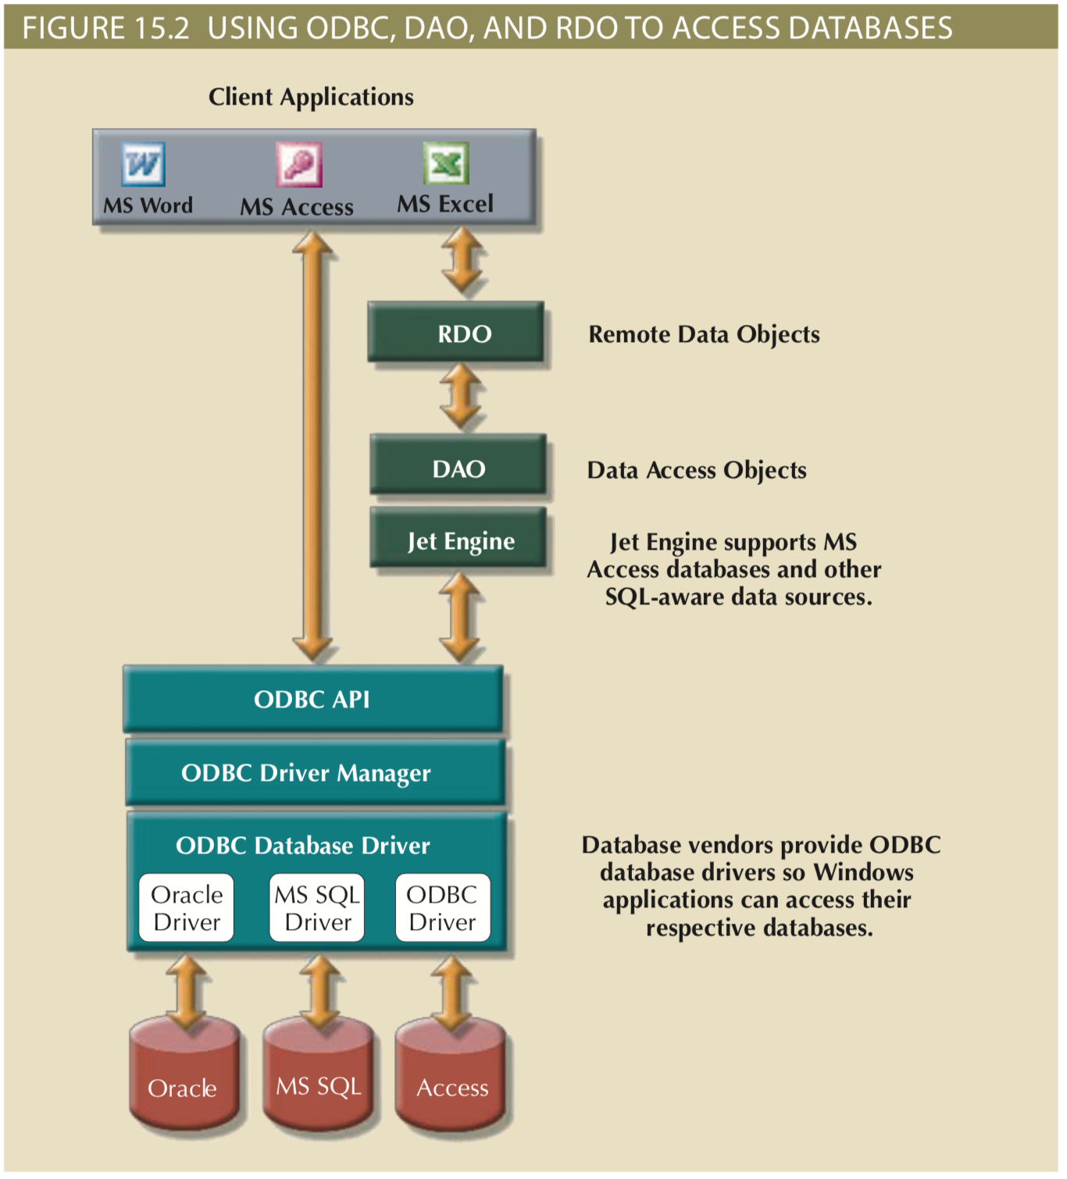
Application
Data Transport Abstraction
Database Interface
Data Store

Slide 23
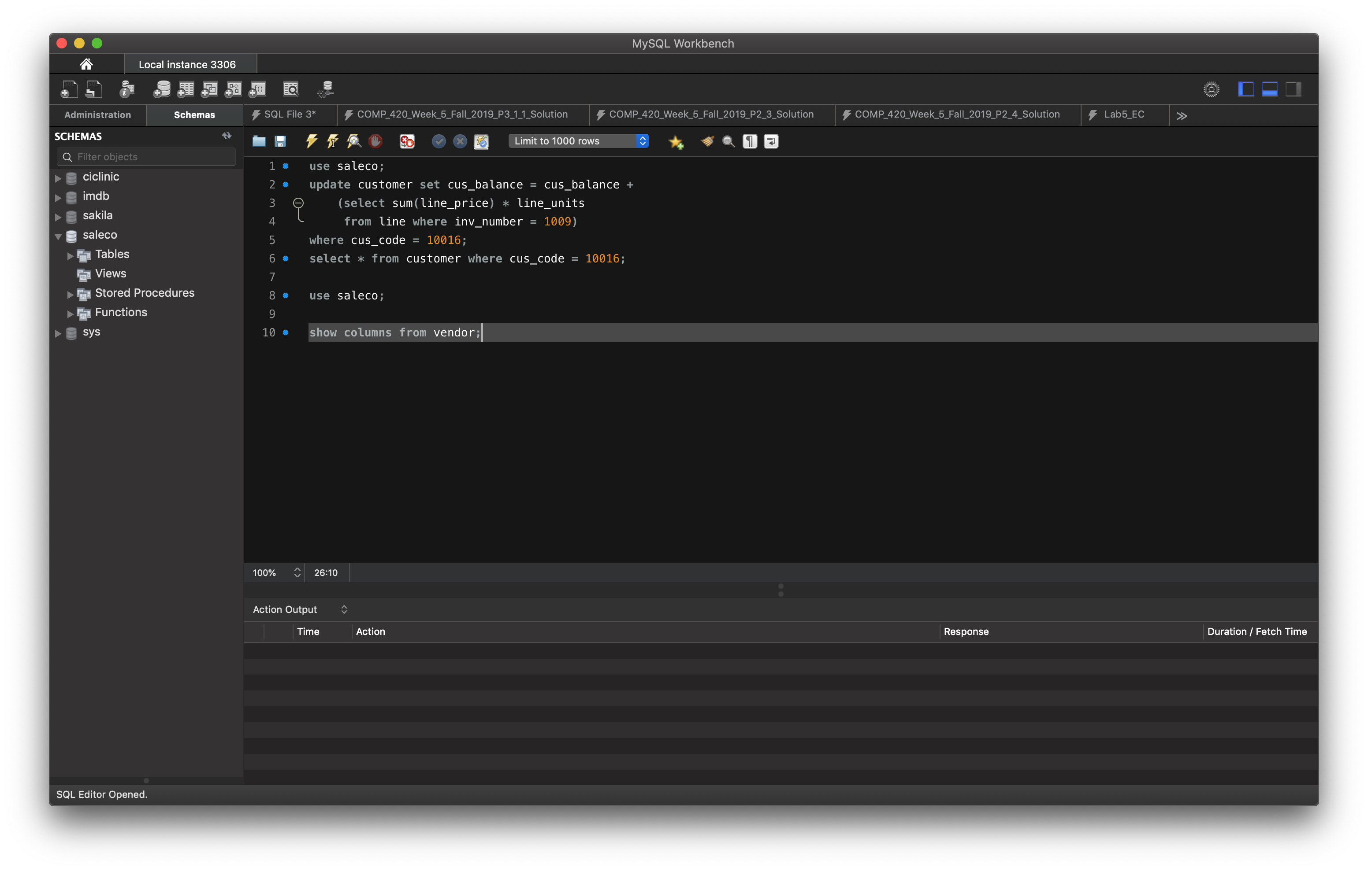
Native SQL Connectivity
Database specific connection framework and utilities

Slide 24
Java Database Connectivity (JDBC)
JDBC is an application programming interface that allows a Java program to interact with a wide-range of data sources.
Basic process is:
Establish a connection with a data source through a driver
Prepare and send SQL (or other DML) commands to server
Receive and process a set of results

Slide 25
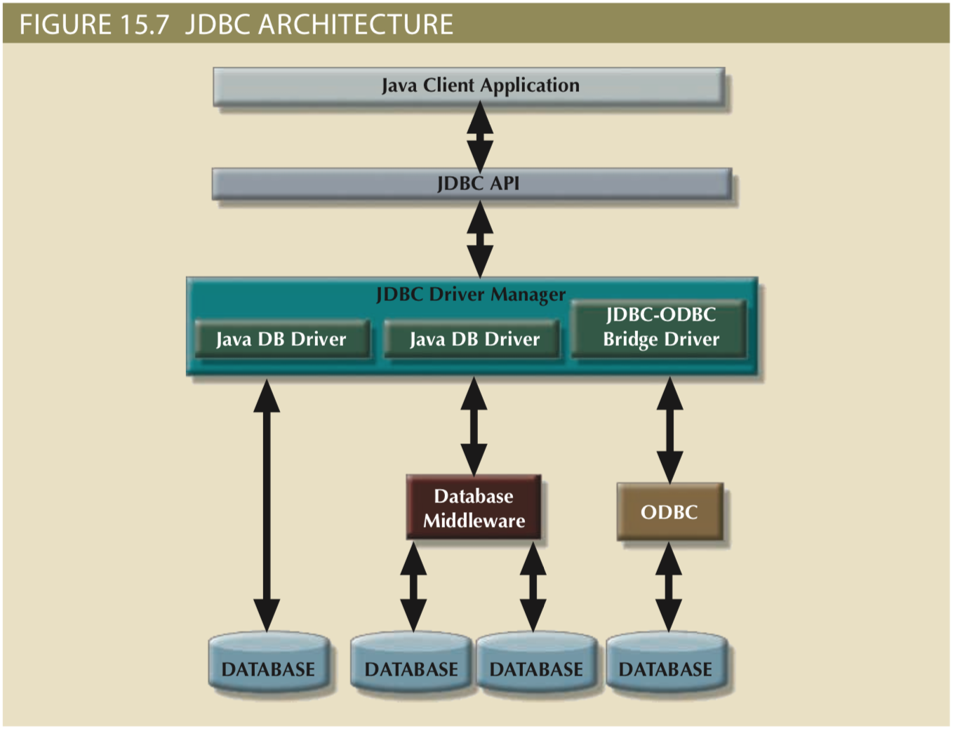

Slide 26

Web Client – Server Architecture
Hey, gimme something.
Here you go.
“Internet Jazz”

Slide 27
My eyes!!
It burns!!

Slide 28
Ahhh…
Much Better

Slide 29
Web Client – Server Architecture
Request
Response

Slide 30
Web Client – Server Architecture
Request
Response
Web Browser
Server Stack
Native Application

Slide 31
Web Client – Server Architecture
Request
Response

Slide 32
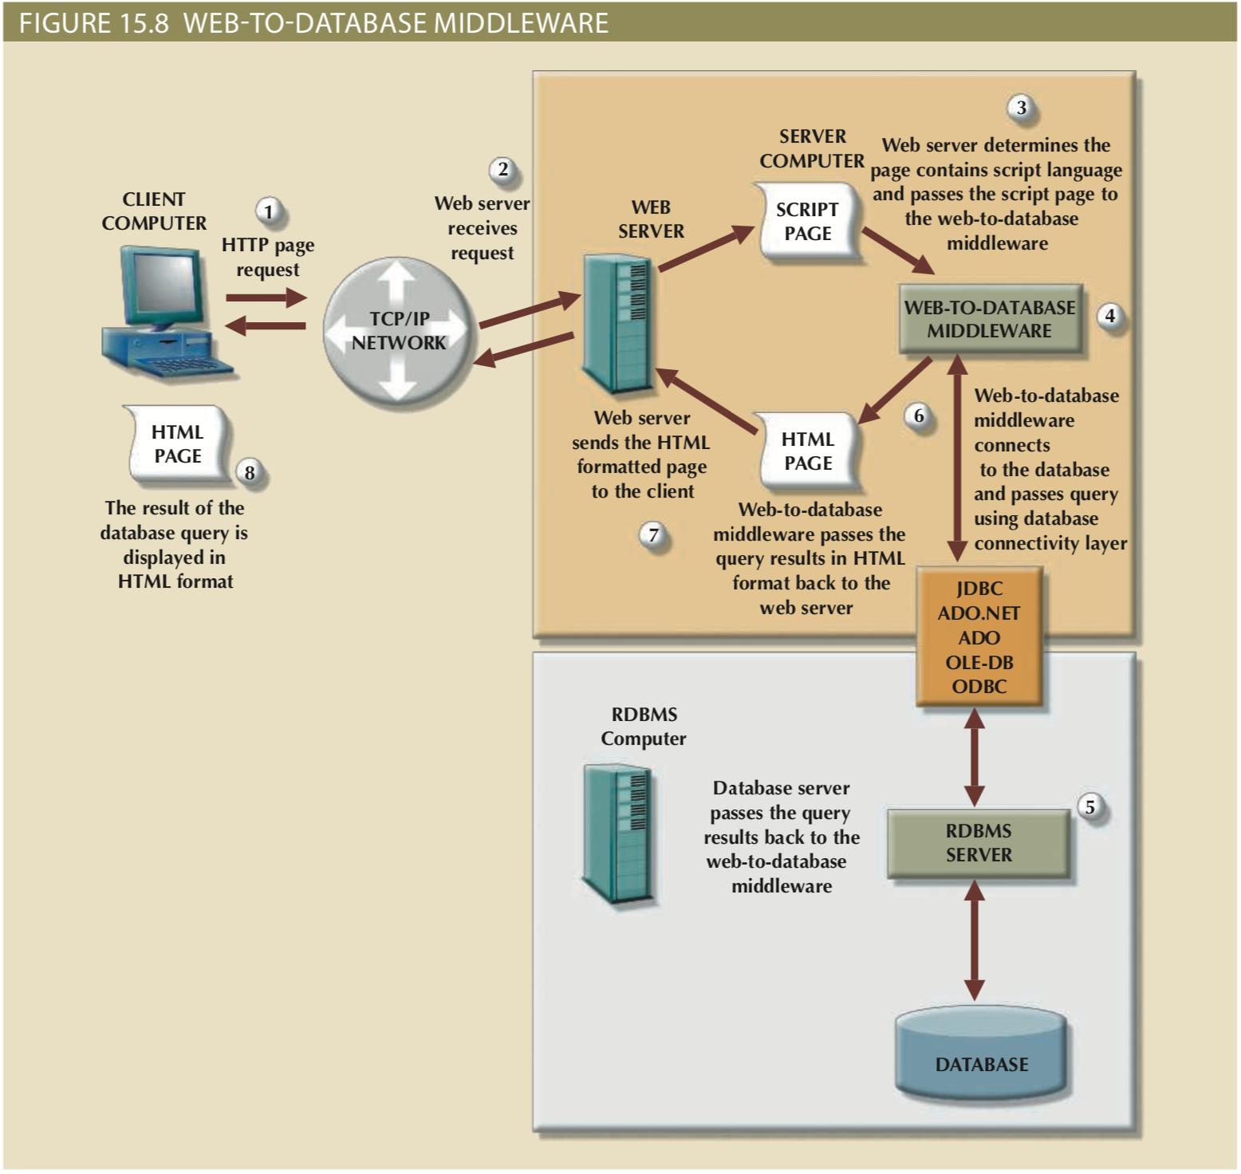
The client browser sends a page request to the web server.
The web server receives and passes the request to the web-to-database middleware for processing.
Generally, the requested page contains some type of scripting language to enable the database interaction. The web server passes the script to the web-to-database middleware.
The web-to-database middleware reads, validates, and executes the script. In this case, it connects to the database and passes the query using the database connectivity layer.

Slide 33
The database server executes the query and passes the result back to the web-to-database middleware.
The web-to-database middleware compiles the result set, dynamically generates an HTML-formatted page that includes the data retrieved from the database, and sends it to the web server.
The web server returns the just-created HTML page, which now includes the query result, to the client browser.
The client browser displays the page on the local computer.

Slide 34
Brief History of Client-Server Architecture
1990s – Common Gateway Interface (CGI), HTTP 1.0, PERL, Java
2000s – Java, RESTful APIs, beginnings of AJAX, Ruby on Rails, Web Application Frameworks
2010s – Python, Cloud Services, Application Servers, Containerization
2020s – Cloud provisioning, Software as a service + 2010s stuff
Textbook is confusingly out of date on a bunch of things

Slide 35
Brief History of Client-Server Architecture
Due to the vast majority of modern applications using the Internet, terrain is changing very quickly
In-house database systems declining for many businesses with outsourcing to cloud services
Computational and network speeds increasing to allow for previously unusable configurations
Interpreted languages
Large data transfers between client and server

Slide 36
MAMP
WAMP

Slide 38
Considerations for Internet Services
Stateless system – Due to the response-request model there is no constant or continuous state
Rapid development is possible due to low-cost of entry, lack of complex compilation pipelines and other native application considerations
Limitations based on client-server model, and browser constraints
Hardware and software independence due to interfaces between components

Slide 39
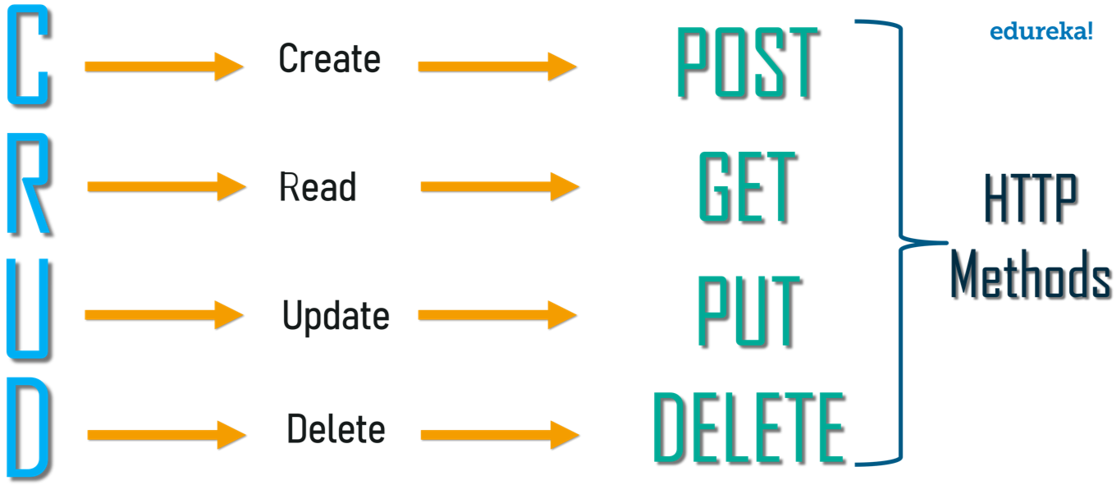
Representational State Transfer (REST)
Means of aligning client and server communications to communicate system state, mainly through HTTP requests

Slide 40
Representational State Transfer (REST)
Means of aligning client and server communications to communicate system state, mainly through HTTP requests

Slide 41



Representational State Transfer (REST)

Slide 42

What is the Cloud?

Slide 43
What is the Cloud?
Historically, anything people at the time don’t understand or want to define:
1980s telecommunications networks
1990s Internet
Currently, massive international configuration of provisioned network infrastructure primarily housed in dedicated data centers

Slide 44
What is the Cloud?
Cloud computing (from NIST) – “a computing model for enabling ubiquitous, convenient, on-demand network access to a shared pool of configurable computer resources (e.g., networks, servers, storage, applications and services) that can be rapidly provisioned and released with minimal management effort or service provider interaction.”
Cloud Services - refer to the services provided by cloud computing
“However, cloud computing itself is still in the early years and needs to mature further before it can be widely adopted. ”
??????? Ignore the book on this

Slide 45
Cloud Scope
Public Cloud
third-party created cloud services available to public and institutions
Private Cloud
internal to a single large organization, may be managed internally or via a third-party manager
Community Cloud
cloud arrangement organized for a common industry or application domain, multi-institution / organization

Slide 46
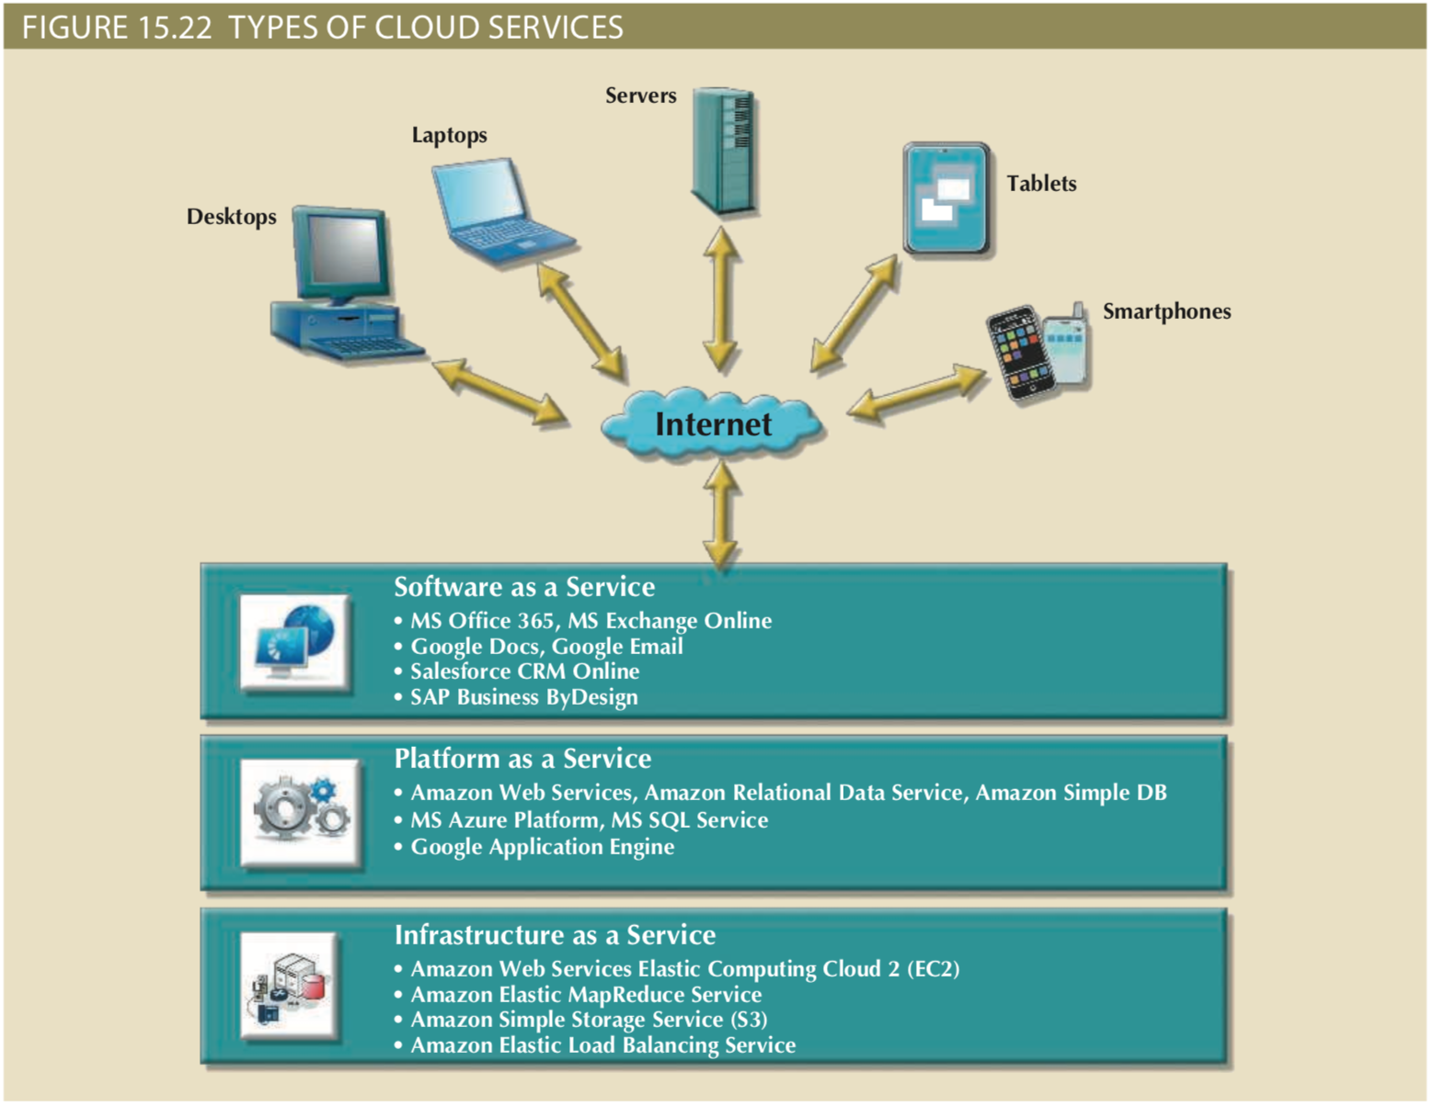

Slide 47
Relevance to Databases?
All of the cloud and application stacks mentioned so far make use of some form of datastore on the backend
Amazon Web Services, Microsoft Azure, etc., allow for quick provisioning of pre-setup machines to scale web application infrastructures, this includes databases and data store solutions
Considerations for database management and design are severely impacted by the new distributed nature of application development and provisioning

Slide 48
Switching Gears to Literal Connections
Database Cursors and Sessions
Overview of a JDBC Example
Overview of a Python MySQL connector example

Slide 49
Database Cursors
A cursor is a special construct in procedural SQL to hold the row results returned by a SQL query.
Cursor provides an interface to iterate over results of a query, typically one row at a time based on calls to a FETCH command.
In SQL, you DECLARE variables to hold each “current” row of information.

Slide 50
Database Session
A database session represents a unit of work that:
maintains a list of objects affected by a business transaction (or multiple transactions in database terms)
coordinates writing out changes (flushing or committing back to system)
resolves concurrency problems
can exist for a single transaction (unadvised) or a group of transactions known as a “conversation”

Slide 51
Java MySQL Connector (JDBC)
Example file included on Canvas
Need to include mysql-connector-java-8.0.23.jar in project

Slide 52
Python MySQL Connector
Example file included on Canvas
Python installation requires mysql-connector package
A bit simpler than the Java example
pip install mysql-connector should work

Slide 53
Java Graphical User Interfaces
AWT
Swing
JavaFX

Slide 54
Python Graphical User Interfaces
TkInter
wxPython
Flask (probably simplest web application framework)
appJar

Slide 55
Object Relational Mapping (ORM)
Frameworks that allow for the mapping between database tuples and programming languages classes
SQLAlchemy – Python
Hibernate – Java

Slide 56
SQLAlchemy Example
Assume that we have a table of ”users” for recorded in our database for a web application.
>>> from sqlalchemy import Column, Integer, String
>>> class User(Base):
... __tablename__ = 'users’
...
... id = Column(Integer, primary_key=True)
... name = Column(String)
... fullname = Column(String)
... nickname = Column(String)
...
... def __repr__(self):
... return "<User(name='%s', fullname='%s', nickname='%s')>" % (
... self.name, self.fullname, self.nickname)

Slide 57
SQLAlchemy Example
>>> User.__table__
Table('users', MetaData(bind=None),
Column('id’, Integer(), table=<users>, primary_key=True, nullable=False),
Column('name', String(), table=<users>),
Column('fullname', String(), table=<users>),
Column('nickname', String(), table=<users>), schema=None)

Slide 58
SQLAlchemy Example
>>> ed_user = User(name='ed', fullname='Ed Jones', nickname='edsnickname’)
... (create a session object)
>>> session.add(ed_user)
>>> session.commit()

Slide 59
SQLAlchemy Example
>>> for instance in session.query(User).order_by(User.id):
... print(instance.name, instance.fullname)
ed Ed Jones
wendy Wendy Williams
mary Mary Contrary
fred Fred Flintstone

Slide 60
JetBrains IDEs
Professional IDEs for most popular languages and systems
Free for students: https://www.jetbrains.com/community/education/#students
IntelliJ Ultimate (Java) and PyCharm (Python)
Includes plug-ins for database integrations and testing.

Slide 61
Database Security
Authorization Management
User access management
User creation and access privileges
User – allow a given person access
Role – authorize a user to use some portion of system
Profile – control how many resources someone can use
View definition
Access rights to derived views
DBMS access control
DBMS usage monitoring

Slide 62
MySQL Database Security
Only root user has ability to manipulate USER table
GRANT and REVOKE statements control access
MySQL provides for password hashing and other encryption protections

Slide 63
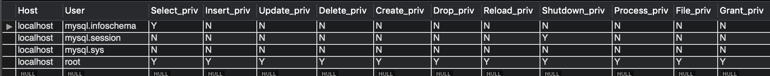
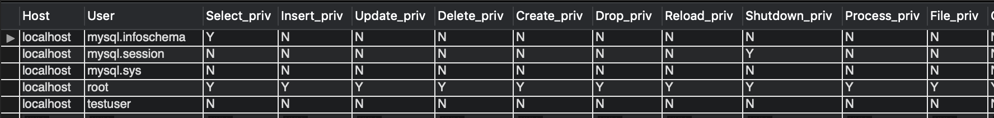
Mysql.User
SELECT * FROM mysql.user;
CREATE USER `testuser`@`localhost` IDENTIFIED BY ‘password123’

Slide 64
GRANT and REVOKE
SHOW GRANTS;
GRANT {function} ON {table} TO `{user}`@`{domain}`
GRANT SELECT ON “*” TO `root`@`localhost`
REVOKE {function} ON {table} TO `{user}`@`{domain}`
REVOKE SELECT ON “*” TO `root`@`localhost`

